Slide 1
CE313 COMPUTER COMMUNICATIONS & COMPUTER NETWORKS

Slide 2
STANDARDS
Standard products
are necessary to ensure that from different manufacturers can
work together as expected.
Data Communication Standards fall in to two categories.
  De facto
  De jure

Slide 3
STANDARD ORGANIZATIONS
International Organization for Standardization (ISO)
International Telecommunication Union- Telecommunication Standards Sector (ITU-T)
American National Standards Institute (ANSI)
Institute of Electrical and Electronics Engineers (IEEE)
Electronics Industries Association (EIA)

Slide 4
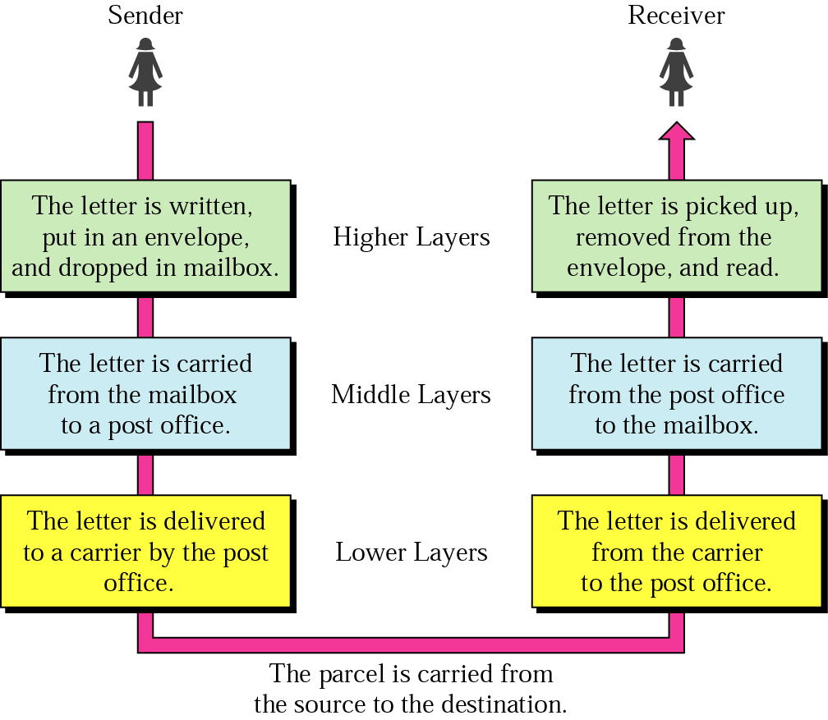
Layered Tasks
An example from the everyday life
Hierarchy?
Services

Slide 5
Why layered communication?
To reduce complexity of communication task by splitting it into several layered small tasks
Functionality of the layers can be changed as long as the service provided to the layer above stays unchanged
  makes easier maintenance & updating
Each layer has its own task
Each layer has its own protocol

Slide 6
Reference Models
OSI reference model
TCP/IP

Slide 7
OSI Reference model
Open System Interconnection
7 layers
Crate a layer when different abstraction is needed
Each layer performs a well define function
Functions of the layers chosen taking internationally standardized protocols
Number of layers – large enough to avoid complexity

Slide 8
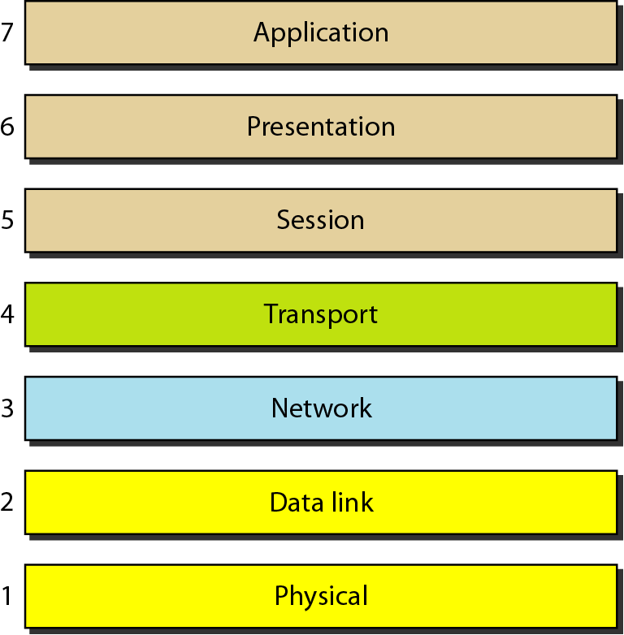
Seven layers of the OSI model

Slide 9
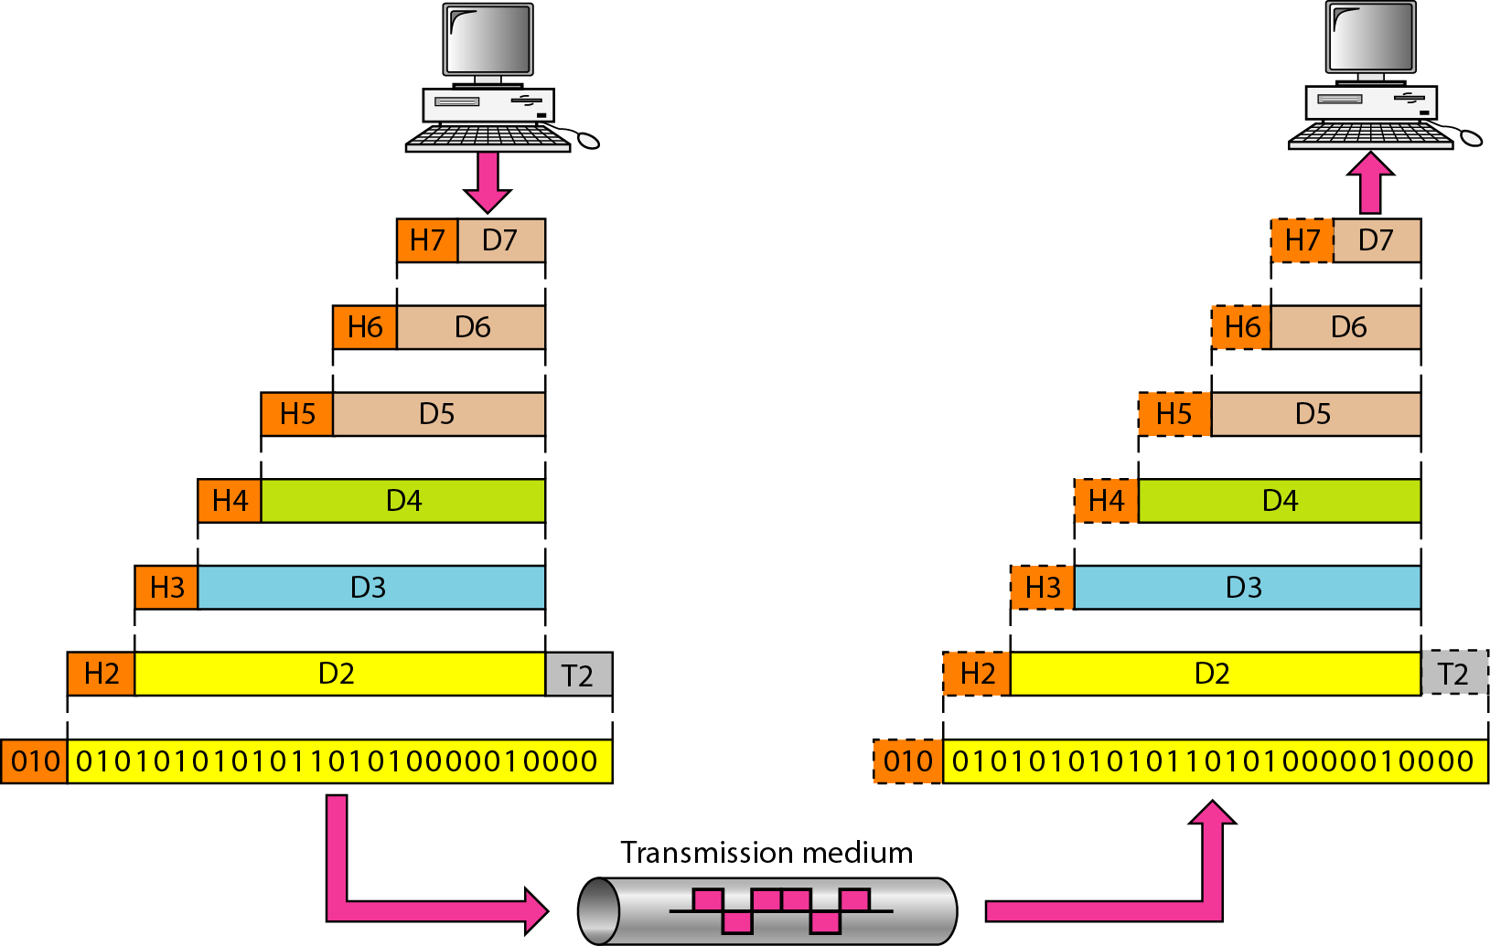
Exchange using OSI Model

Slide 10
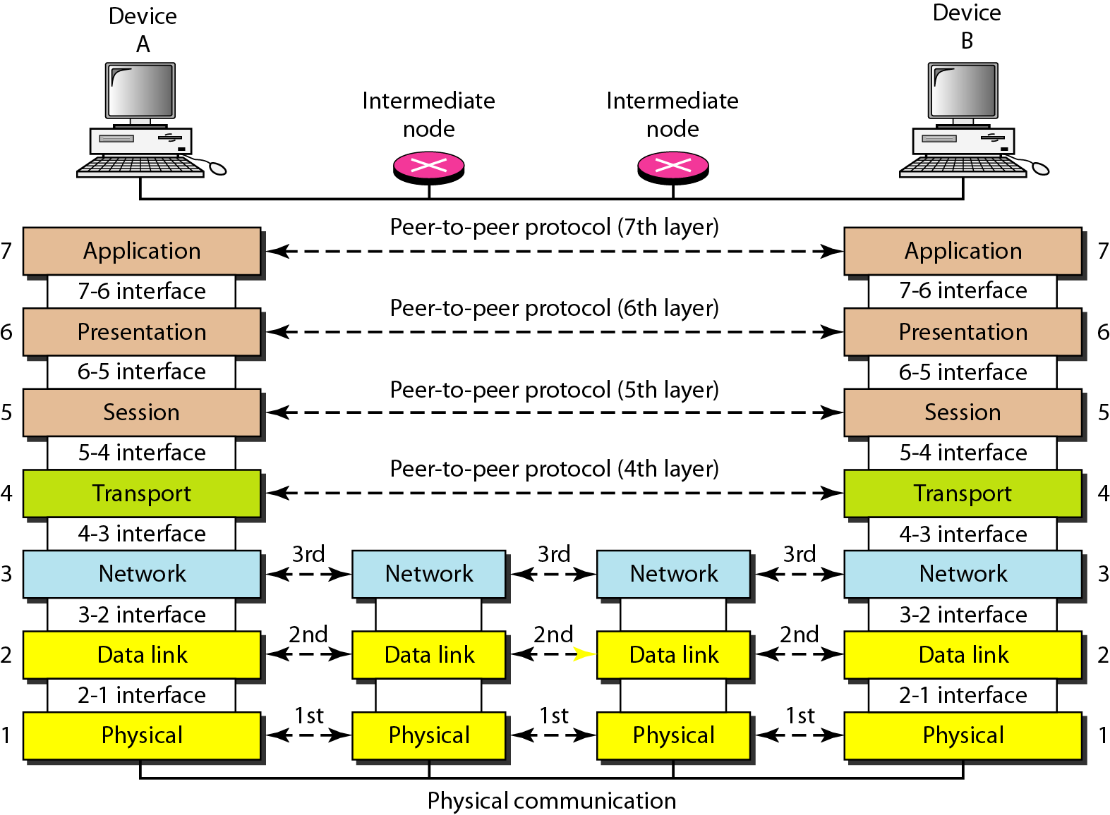
The interaction between layers in the OSI model

Slide 11
Issues, to be resolved by the layers
Larger bandwidth at lower cost
Error correction
Flow control
Addressing
Multiplexing
Naming
Congestion control
Mobility
Routing
Fragmentation
Security
....

Slide 12
OSI Layers

Slide 13
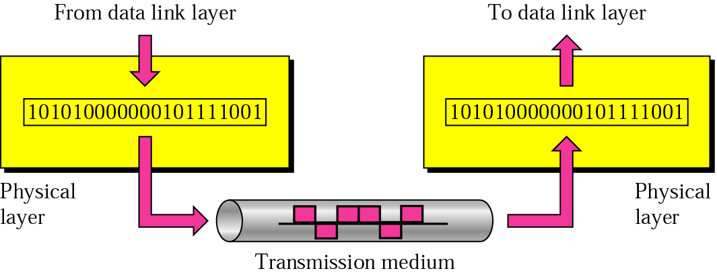
Physical layer
physical
connection
Transporting bits from one end node to the next
type of the transmission media (twisted-pair, coax, optical fiber, air)
bit representation (voltage levels of logical values)
data rate (speed)
synchronization of bits (time synchronization)

Slide 14

Note
The physical layer is responsible for movements of
individual bits from one hop (node) to the next.

Slide 15
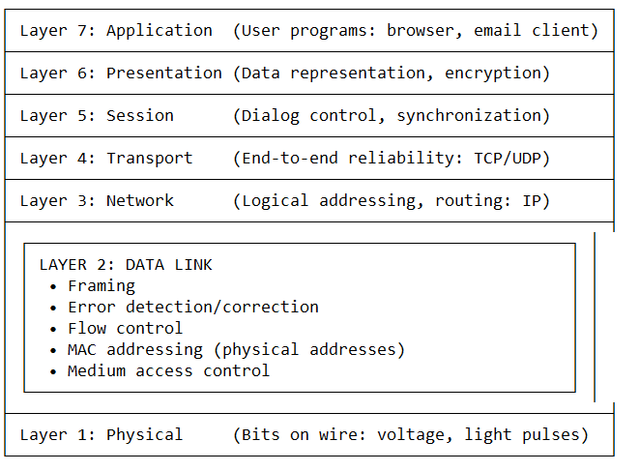

Slide 16
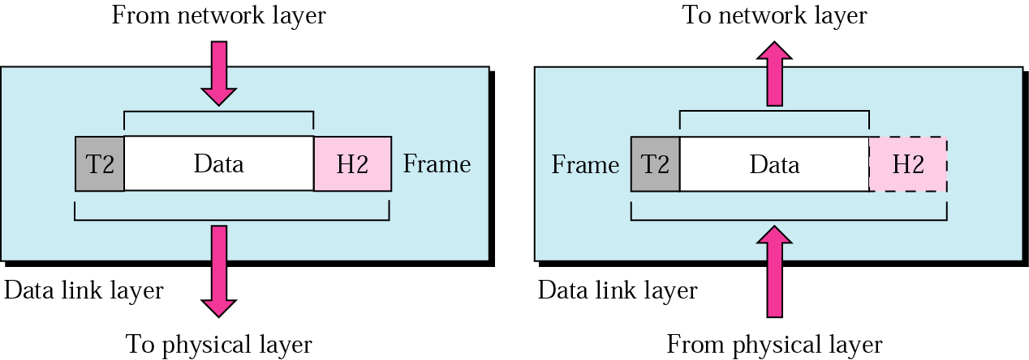
Data Link layer
logical
connection
Transporting frames from one end node to the next one
- framing - physical addressing
- flow control - error control
access control

Slide 17
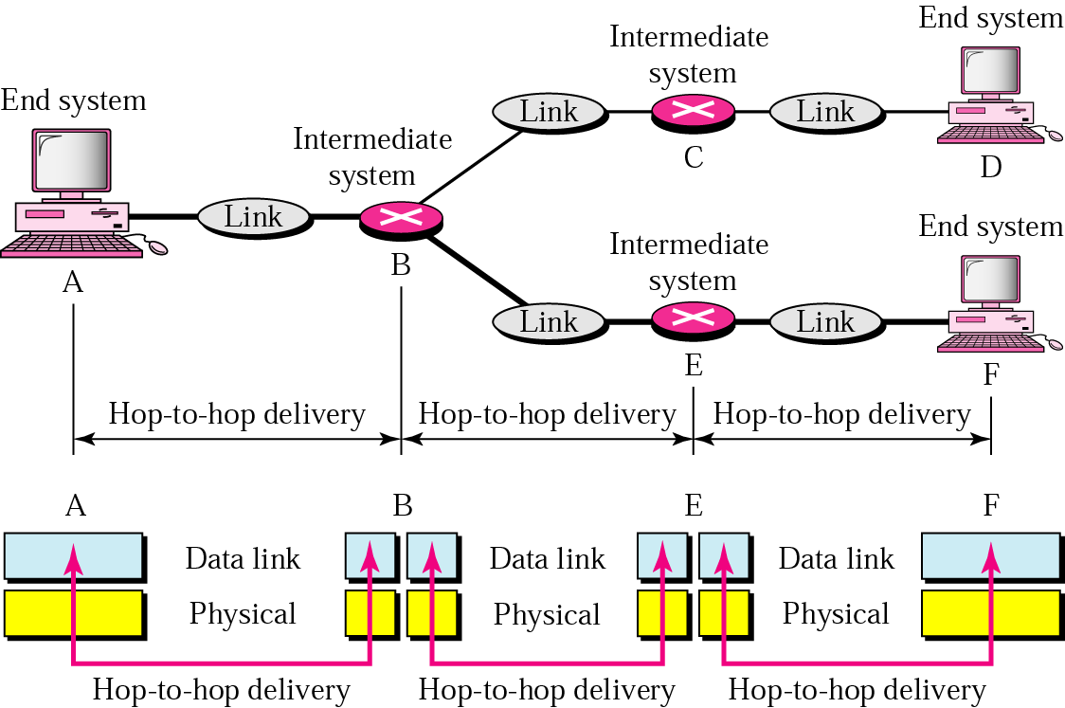
Data Link layer
- hop-to-hop delivery-

Slide 18
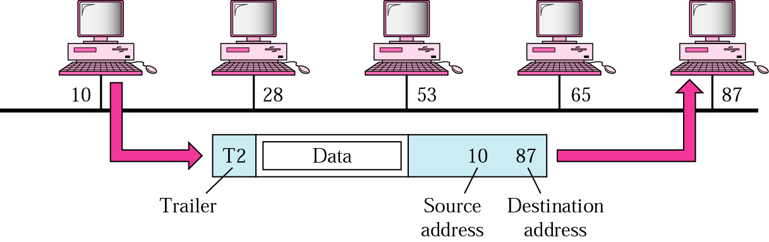
Data Link layer
- example-

Slide 19
Note
The data link layer is responsible for moving
frames from one hop (node) to the next.

Slide 20
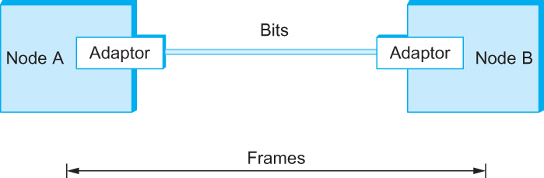
Framing
We are focusing on packet-switched networks, which means that blocks of data (called frames at this level), not bit streams, are exchanged between nodes.
It is the network adaptor that enables the nodes to exchange frames.
Bits flow between adaptors, frames between hosts

Slide 21
Why Framing?
Without framing, receiver sees continuous bit stream:

Slide 22
Why Framing?
Without framing, receiver sees continuous bit stream:
Without framing, receiver sees continuous bit stream
Transmitted: [FRAME1][FRAME2][FRAME3]...
Received: 01011010011010101100101011010101011010...
Problem: Where does Frame 1 end? Where does Frame 2 start?

Slide 23
Framing
When node A wishes to transmit a frame to node B, it tells its adaptor to transmit a frame from the node’s memory. This results in a sequence of bits being sent over the link.
The adaptor on node B then collects together the sequence of bits arriving on the link and deposits the corresponding frame in B’s memory.
Recognizing exactly what set of bits constitute a frame—that is, determining where the frame begins and ends—is the central challenge faced by the adaptor

Slide 24
Framing
BISYNC – sentinel approach
  Frames transmitted beginning with leftmost field
  Beginning of a frame is denoted by sending a special SYN (synchronize) character
  Data portion of the frame is contained between special sentinel character STX (start of text) and ETX (end of text)
  SOH : Start of Header
  DLE : Data Link Escape
  CRC: Cyclic Redundancy Check

Slide 25
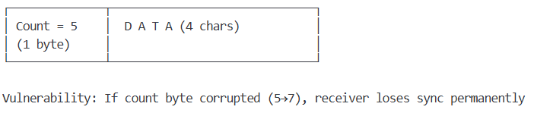
Framing
Byte-counting approach OR Character Count (Obsolete – Included for Historical Context)
  DDCMP
  count : how many bytes are contained in the frame body
  If count is corrupted
    Framing error

Slide 26
Framing
Byte-oriented Protocols
  To view each frame as a collection of bytes (characters) rather than bits
  BISYNC (Binary Synchronous Communication) Protocol
    Developed by IBM (late 1960)
  DDCMP (Digital Data Communication Protocol)
    Used in DECNet

Slide 27

Framing
BISYNC Frame Format

Slide 28
Framing
Recent PPP which is commonly run over Internet links uses sentinel approach
  Special start of text character denoted as Flag
    0 1 1 1 1 1 1 0
  Address, control : default numbers
  Protocol for demux : IP / IPX
  Payload : negotiated (1500 bytes)
  Checksum : for error detection

Slide 29
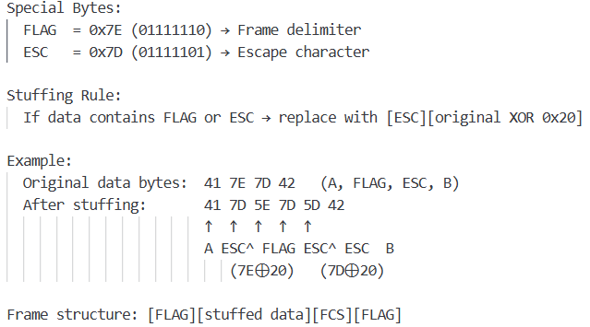
Framing Techniques
Flag Bytes with Byte Stuffing (PPP – Point-to-Point Protocol)

Slide 30

Framing
PPP Frame Format

Slide 31

Framing
DDCMP Frame Format

Slide 32

Framing
Bit-oriented Protocol
  HDLC : High Level Data Link Control
    Beginning and Ending Sequences
      0 1 1 1 1 1 1 0
HDLC Frame Format

Slide 33
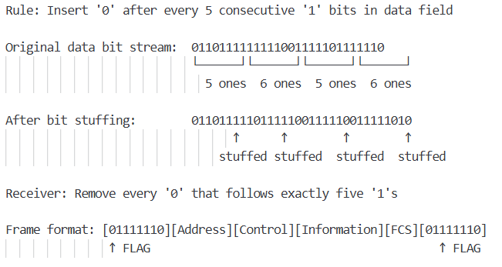
HDLC Protocol
  On the sending side, any time five consecutive 1’s have been transmitted from the body of the message (i.e. excluding when the sender is trying to send the distinguished 01111110 sequence)
    The sender inserts 0 before transmitting the next bit

Slide 34
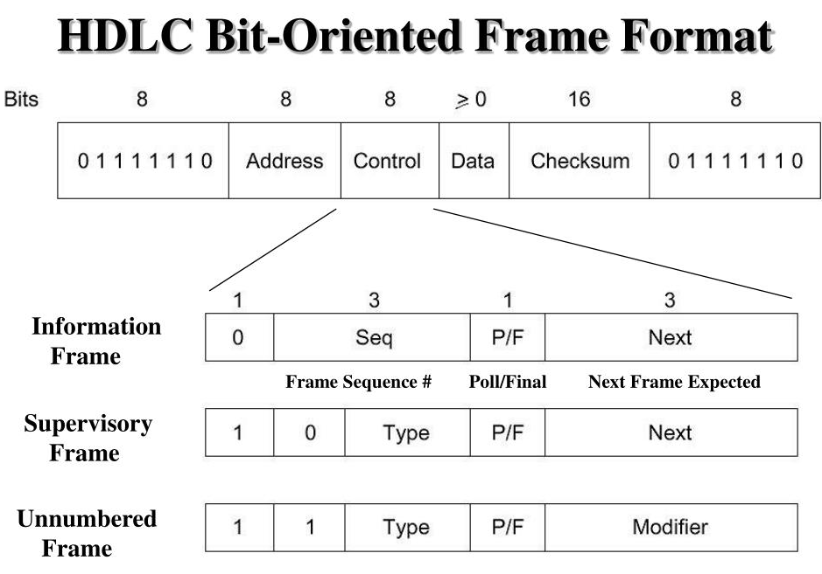

Slide 35
HDLC Protocol
  On the receiving side
    5 consecutive 1’s
      Next bit 0 : Stuffed, so discard it
      1 : Either End of the frame marker
      Or Error has been introduced in the bitstream
      Look at the next bit
      If 0 ( 01111110 ) → End of the frame marker
      If 1 ( 01111111 ) → Error, discard the whole frame
      The receiver needs to wait for next
      01111110 before it can start
      receiving again

Slide 36
Bit Stuffing Algorithm
  def bit_stuff(data_bits):
  stuffed = []
  consecutive_ones = 0
  for bit in data_bits:
  stuffed.append(bit)
  if bit == 1:
  consecutive_ones += 1
  if consecutive_ones == 5: # After 5 consecutive 1s
  stuffed.append(0) # Insert stuff bit
  consecutive_ones = 0 # Reset counter
  else:
  consecutive_ones = 0
  return stuffed

Slide 37
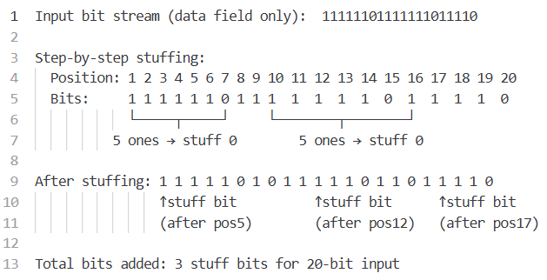
Bit Stuffing Example

Slide 38
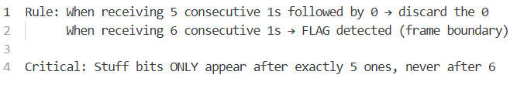
Bit De-Stuffing

Slide 39
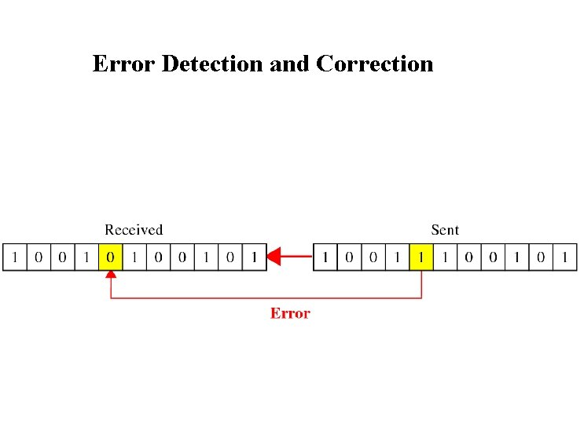

Slide 40
Error Detection
Bit errors are introduced into frames
  Because of electrical interference and thermal noises
Detecting Error
Correction Error
Two approaches when the recipient detects an error
  Notify the sender that the message was corrupted, so the sender can send again.
    If the error is rare, then the retransmitted message will be error-free
  Using some error correct detection and correction algorithm, the receiver reconstructs the message

Slide 41
Error Detection
Common technique for detecting transmission error
  CRC (Cyclic Redundancy Check)
    Used in HDLC, DDCMP, CSMA/CD, Token Ring
  Other approaches
    Two Dimensional Parity (BISYNC)
    Checksum (IP)

Slide 42
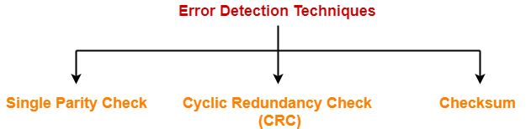

Slide 43
Error Detection
Basic Idea of Error Detection
  To add redundant information to a frame that can be used to determine if errors have been introduced
  Imagine (Extreme Case)
    Transmitting two complete copies of data
      Identical → No error
      Differ → Error
      Poor Scheme ???
        n bit message, n bit redundant information
        Error can go undetected
    In general, we can provide strong error detection technique
      k redundant bits, n bits message, k << n
      In Ethernet, a frame carrying up to 12,000 bits of data requires only 32-bit CRC

Slide 44
Error Detection
Extra bits are redundant
  They add no new information to the message
  Derived from the original message using some algorithm
  Both the sender and receiver know the algorithm
  Sender Receiver
Receiver computes r using m
If they match, no error
m
r
m
r

Slide 45
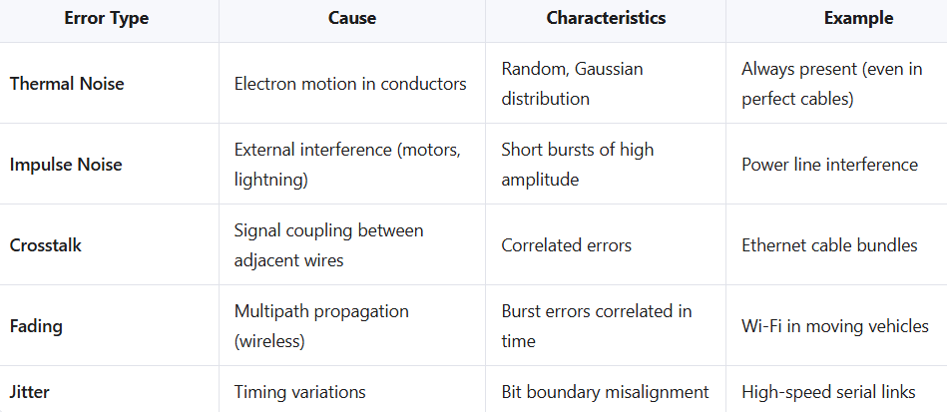
Error Sources in Physical Channels

Slide 46
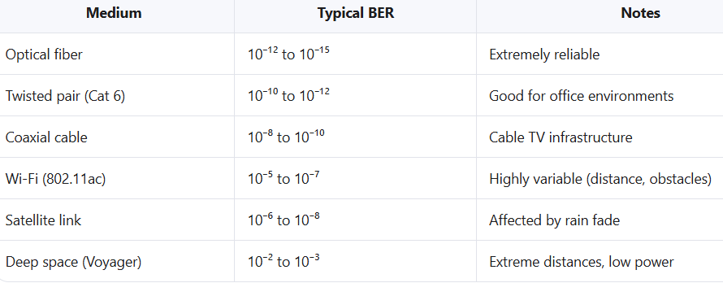
Realtime Bit Error Rate (BER)

Slide 47
Error detection
EDC: error detection and correction bits (e.g., redundancy)
D: data protected by error checking, may include header fields
Error detection not 100% reliable!
  protocol may miss some errors, but rarely
  larger EDC field yields better detection and correction
datagram
datagram
otherwise
all
bits in D’
OK
?
N
detected
error
d data bits
D
EDC
D’
EDC’
bit-error prone link

Slide 48
Parity checking
single bit parity:
detect single bit errors
two-dimensional bit parity:
detect and correct single bit errors
1
row parity
0111000110101011
d_{1,1}
. . .
d_{1,j}
d_{1,j+1}
d data bits
d_{2,1}
. . .
d_{2,j}
d_{2,j+1}
parity
bit
. . .
. . .
. . .
. . .
d_{i,1}
. . .
d_{i,j}
d_{i,j+1}
column
parity
. . .
Even parity: set parity bit so there is an even number of 1’s
d_{i+1,1}
d_{i+1,j}
d_{i+1,j+1}
no errors:
1 0 1 0 1 1
detected
and
correctable
single-bit
error:
1 0 1 0 1 1
1 1 1 1 0 0
1 0 1 1 0 0
parity
error
0 1 1 1 0 1
0 1 1 1 0 1
1 0 1 0 1 0
1 0 1 0 1 0
* Check out the online interactive exercises for more examples: http://gaia.cs.umass.edu/kurose_ross/interactive/
parity
error

Slide 49
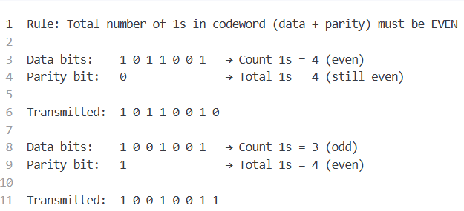
Single Bit Parity checking (Even Parity)

Slide 50
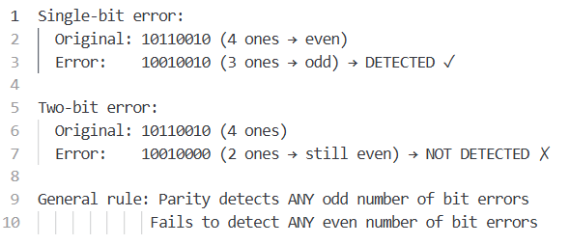
Single Bit Parity checking (Capability)

Slide 51
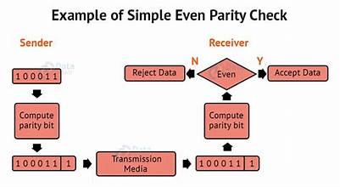

Slide 52
Two-dimensional parity
Two-dimensional parity is exactly what the name suggests
It is based on “simple” (one-dimensional) parity, which usually involves adding one extra bit to a 7-bit code to balance the number of 1s in the byte. For example,
  Odd parity sets the eighth bit to 1 if needed to give an odd number of 1s in the byte, and
  Even parity sets the eighth bit to 1 if needed to give an even number of 1s in the byte

Slide 53
Two-dimensional parity
Two-dimensional parity does a similar calculation for each bit position across each of the bytes contained in the frame
This results in an extra parity byte for the entire frame, in addition to a parity bit for each byte
Two-dimensional parity catches all 1-, 2-, and 3-bit errors and most 4-bit errors

Slide 54
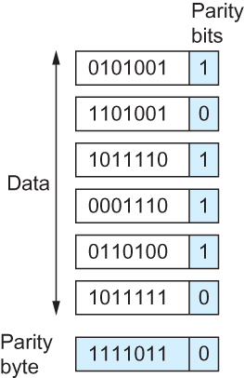
Two-dimensional parity
Two Dimensional Parity

Slide 55
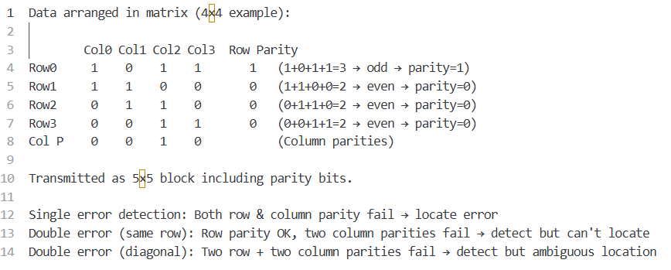
2D Bit Parity checking (Longitudinal + Vertical)

Slide 56
Internet checksum
Goal: detect errors (i.e., flipped bits) in transmitted segment
sender:
treat contents of UDP segment (including UDP header fields and IP addresses) as sequence of 16-bit integers
checksum: addition (one’s complement sum) of segment content
checksum value put into UDP checksum field
receiver:
compute checksum of received segment
check if computed checksum equals checksum field value:
  not equal - error detected
  equal - no error detected. But maybe errors nonetheless? More later ….

Slide 57
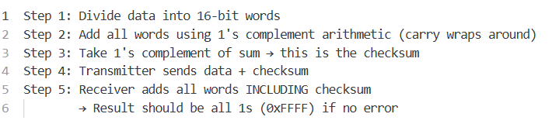
Internet checksum

Slide 58
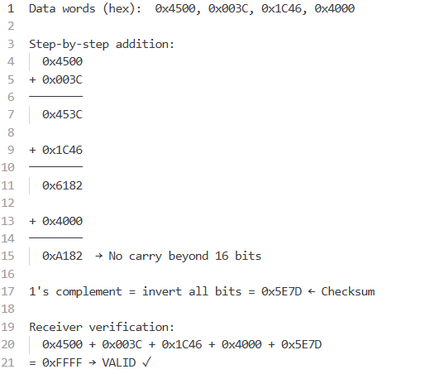
Compliment Arithmetic Example

Slide 59
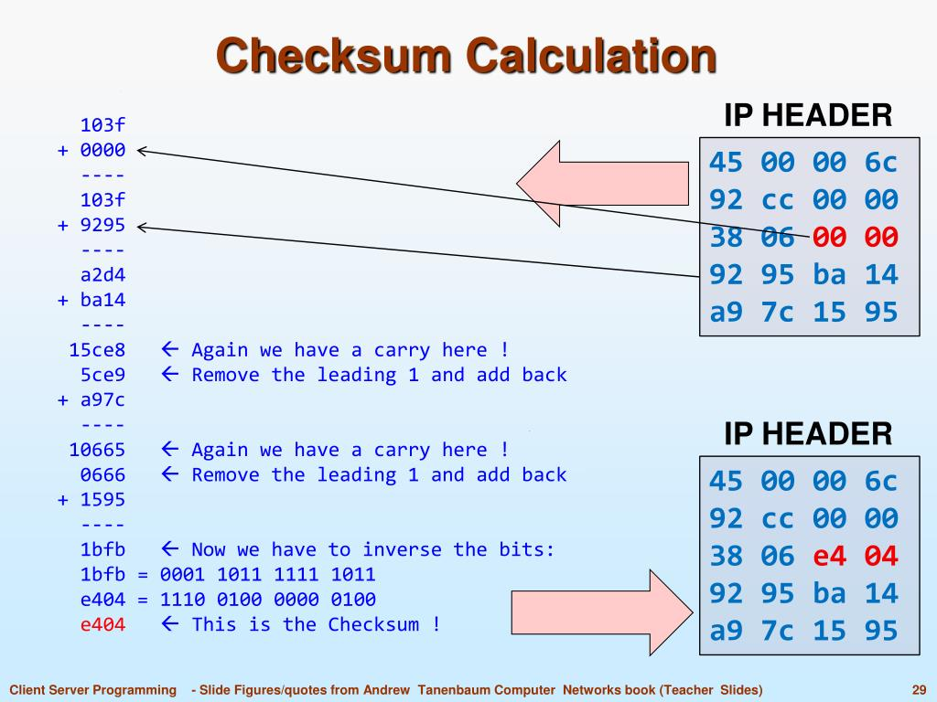

Slide 60
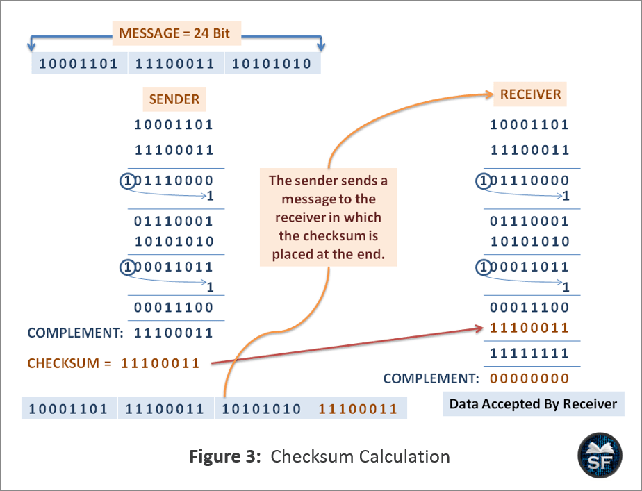

Slide 61
Internet Checksum Algorithm
Not used at the link level
Add up all the words that are transmitted and then transmit the result of that sum
  The result is called the checksum
The receiver performs the same calculation on the received data and compares the result with the received checksum
If any transmitted data, including the checksum itself, is corrupted, then the results will not match, so the receiver knows that an error occurred

Slide 62
Internet Checksum Algorithm
Consider the data being checksummed as a sequence of 16-bit integers.
Add them together using 16-bit ones complement arithmetic (explained next slide) and then take the ones complement of the result.
That 16-bit number is the checksum

Slide 63
Internet Checksum Algorithm
In ones complement arithmetic, a negative integer −x is represented as the complement of x;
  Each bit of x is inverted.
When adding numbers in ones complement arithmetic, a carryout from the most significant bit needs to be added to the result.

Slide 64
Internet Checksum Algorithm
Consider, for example, the addition of −5 and −3 in ones complement arithmetic on 4-bit integers
  +5 is 0101, so −5 is 1010; +3 is 0011, so −3 is 1100
If we add 1010 and 1100 ignoring the carry, we get 0110
In ones complement arithmetic, the fact that this operation caused a carry from the most significant bit causes us to increment the result, giving 0111, which is the ones complement representation of −8 (obtained by inverting the bits in 1000), as we would expect

Slide 65
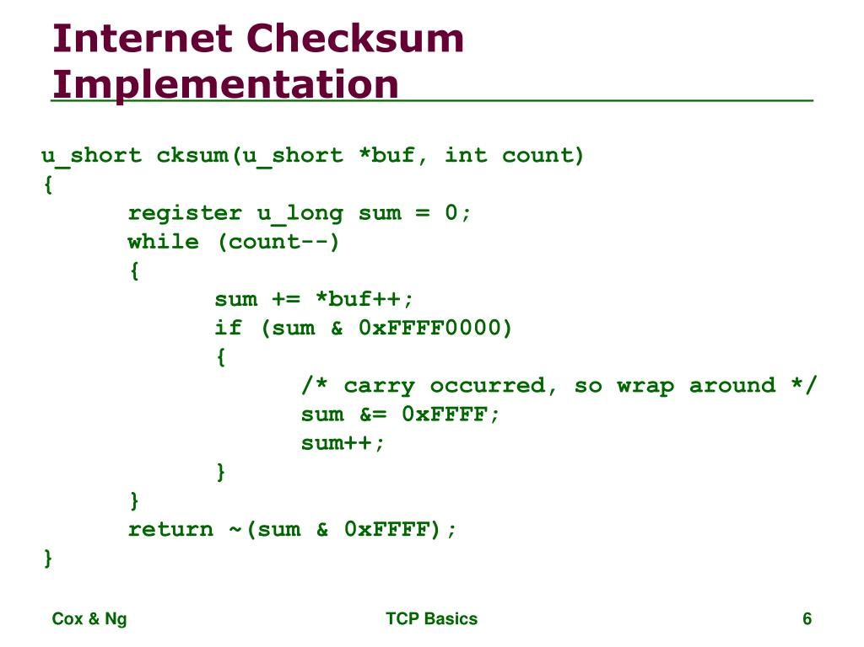

Slide 66
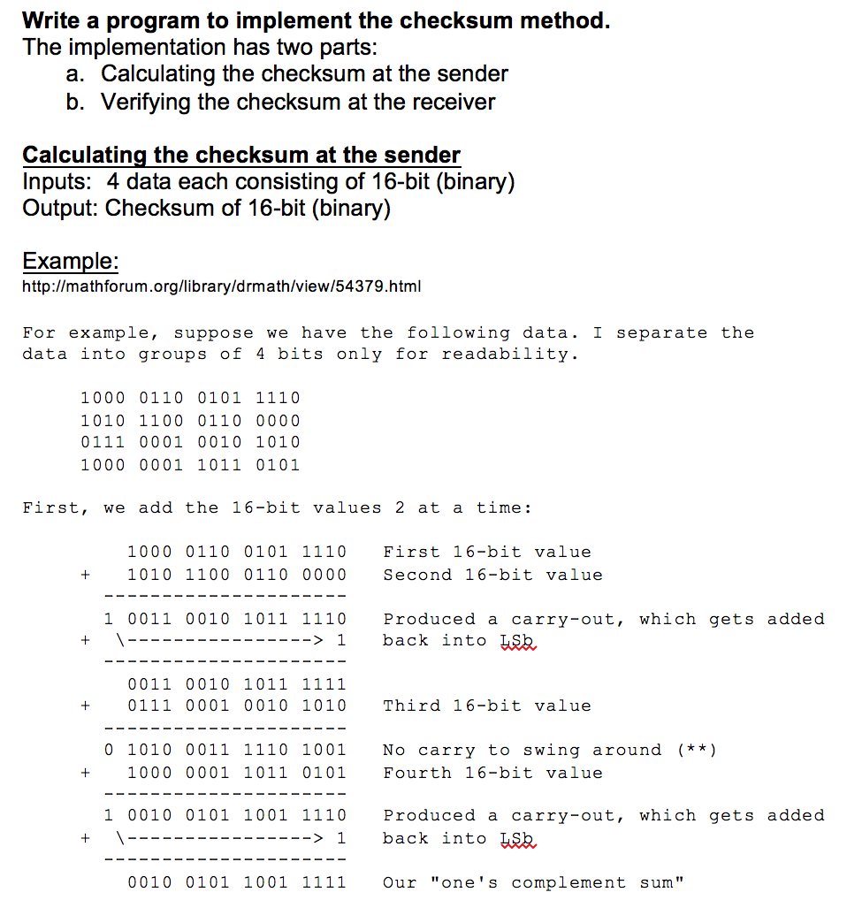

Slide 67
Readings
Tanenbaum & Wetherall, Computer Networks, 6th Ed., Ch. 3
Forouzan, Data Communications and Networking, Ch. 10–11
IEEE 802.3-2022 – Ethernet MAC/PHY standards
IEEE 802.11-2020 – Wireless LAN MAC/PHY specifications
Peterson & Davie, Computer Networks: A Systems Approach, Ch. 2
Lin & Costello, Error Control Coding, 2nd Ed. (advanced theory)
Chapter 1 (B. A Forouzan)
  Section 1.1, 1.2, 1.3,1.4
8. Chapter 2 (B.A Forouzan)
  Section 2.1, 2.2

Slide 68
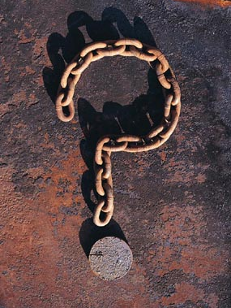

Slide 69
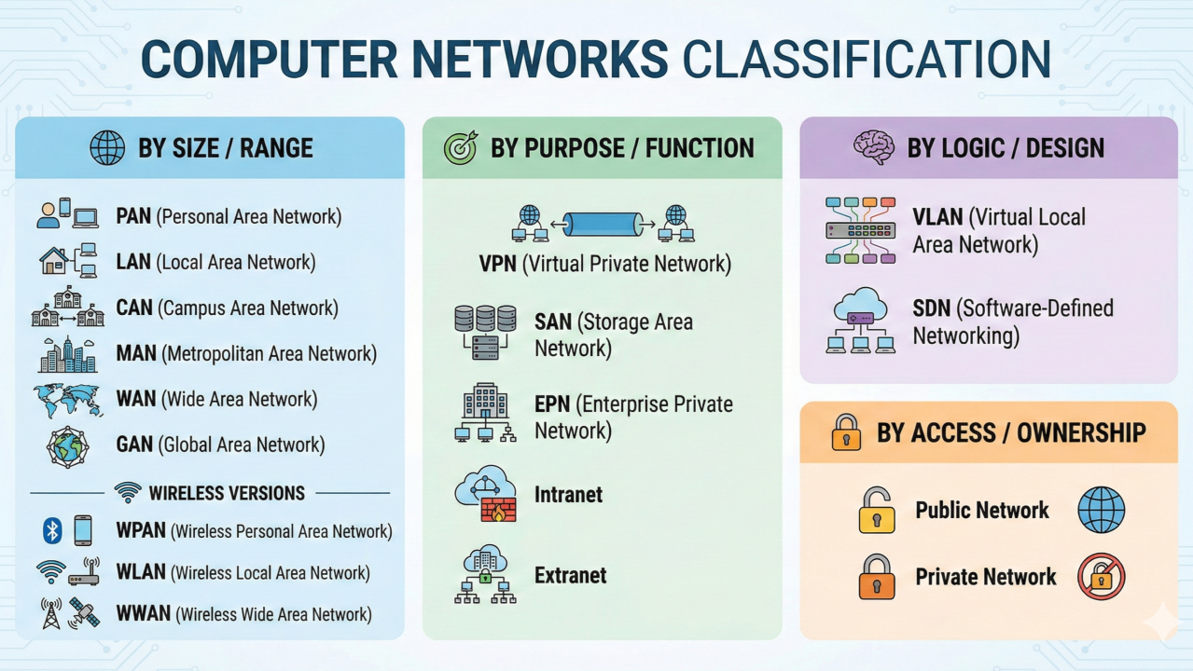

Slide 70
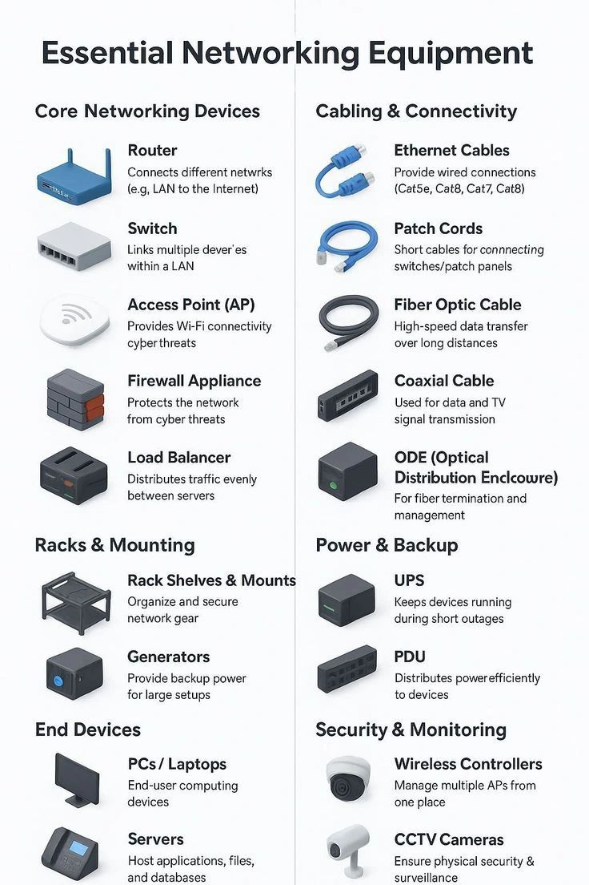

Slide 71
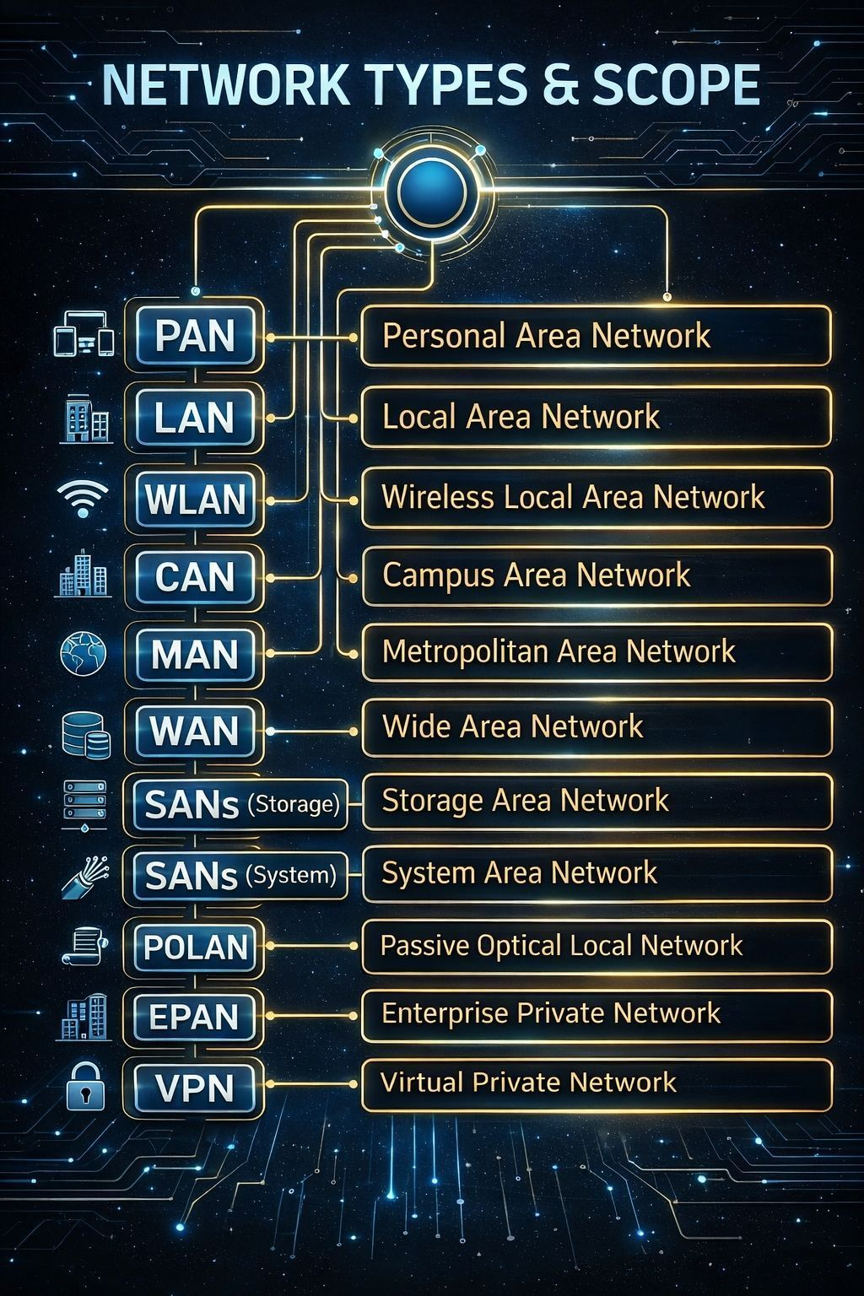

Slide 72
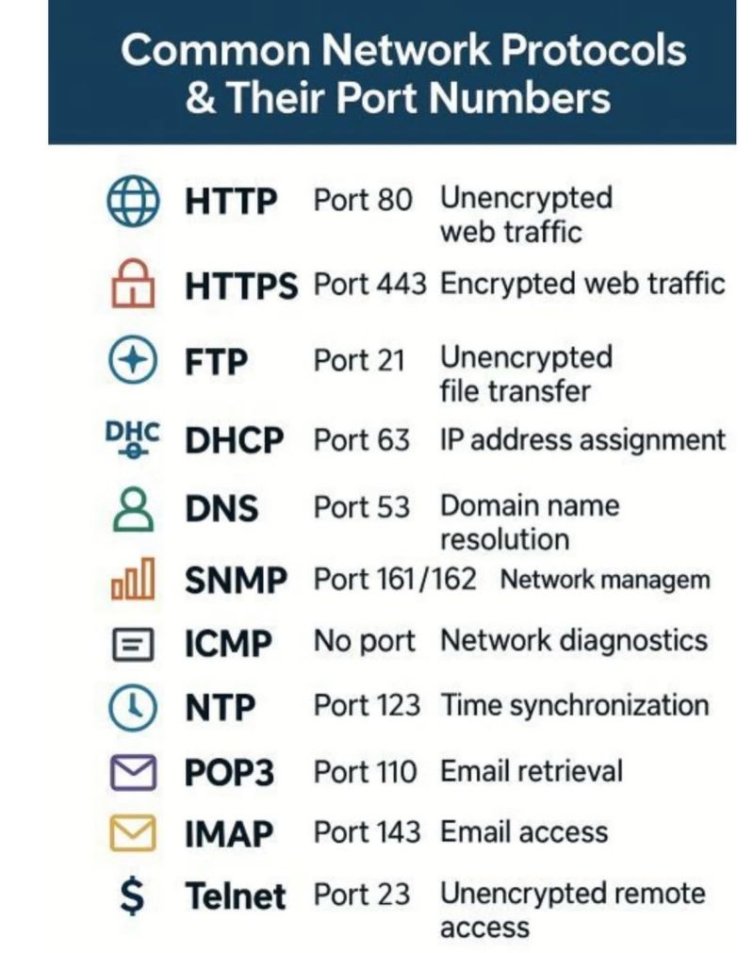

Slide 73
